Slide 1

802.11
tricks & treats by @090h

Slide 2
802.11 basics

Slide 3
__init__
Created by: NCR Corporation/AT&T
Invention: 1991 (Wave LAN)
Father: Vic Hayes
Name: taken from Hi-Fi
Frequency: 2.4GHz UHF and 5GHz SHF
Public release: 1997
Maximum speed: 2Mbit/s

Slide 4
802.11 legacy
Date: June 1997
Frequency: 2.4 GHz
Bandwidth: 22 MHz
Modulation: DSSS, FHSS
Data rate: 1, 2 Mbit/s
Range indoor: 20m
Range outdoor: 100m

Slide 5
802.11a
Date: September 1999
Frequency: 5, 3.7 GHz
Modulation: OFDM
Bandwidth: 20 MHz
Speed: 6, 9, 12, 18, 24, 36, 48, 54 Mbit/s
Range indoor: 35m
Range outdoor: 120m

Slide 6
802.11b
Date: September 1999
Frequency: 2.4 GHz
Modulation: DSSS
Bandwidth: 22 MHz
Speed: 1, 2, 5.5, 11 Mbit/s
Range indoor: 35m
Range outdoor: 140m

Slide 7
802.11g
Date: September 2003
Frequency: 2.4 GHz
Modulation: OFDM,DSSS
Bandwidth: 20 MHz
Speed: 6, 9, 12, 18, 24, 36, 48, 54 Mbit/s
Range indoor: 38m
Range outdoor: 140m

Slide 8
802.11n
Date: October 2009
Frequency: 2.4/5 GHz
Modulation: OFDM
Bandwidth: 20 MHz, 40 MHz
Speed in Mbit/s
[ 7.2, 14.4, 21.7, 28.9, 43.3, 57.8, 65, 72.2 ]
[ 15, 30, 45, 60, 90, 120, 135, 150 ]
Range indoor: 70m
Range outdoor: 250m
MIMO: 4x4 or SISO: 1x1

Slide 9
802.11ac
Date: December 2013
Frequency: 5 GHz
Modulation: OFDM
Bandwidth: 20 MHz, 40 MHz, 80 MHz, 160 MHz
Speed in Mbit/s
[ 7.2, 14.4, 21.7, 28.9, 43.3, 57.8, 65, 72.2, 86.7, 96.3 ]
[ 15, 30, 45, 60, 90, 120, 135, 150, 180, 200 ]
[ 32.5, 65, 97.5, 130, 195, 260, 292.5, 325, 390, 433.3 ]
[ 65, 130, 195, 260, 390, 520, 585, 650, 780, 866.7 ]
Range indoor: 35m Range outdoor: NO!
MIMO: 8x8 streams!

Slide 10
802.11 1999-2016
802.11 standard evolution
IEEE Standard | 802.11a | 802.11b | 802.11g | 802.11n | 802.11ac
Year Adopted | 1999 | 1999 | 2003 | 2009 | 2014
Frequency | 5 GHz | 2.4 GHz | 2.4 GHz | 2.4/5 GHz | 5 GHz
Max. Data Rate | 54 Mbps | 11 Mbps | 54 Mbps | 600 Mbps | 1 Gbps
Typical Range Indoors* | 100 ft. | 100 ft. | 125 ft. | 225 ft. | 90 ft.
Typical Range Outdoors* | 400 ft. | 450 ft. | 450 ft. | 825 ft. | 1,000 ft.

Slide 11
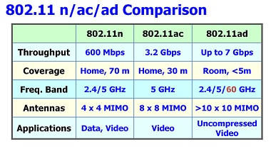
Nearest future

Slide 12
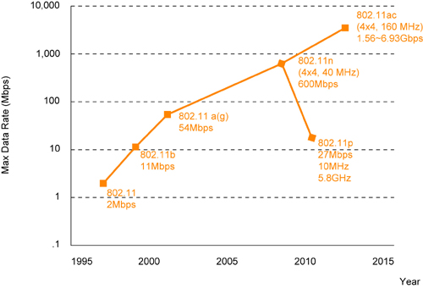
802.11 SPEED² EVOLUTION

Slide 13
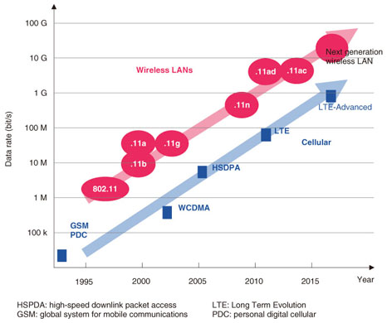

Slide 14
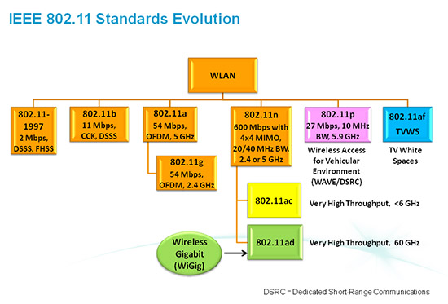

Slide 15
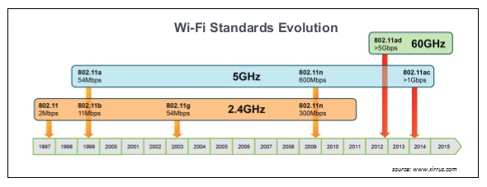

Slide 16
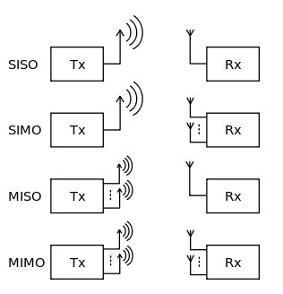
SISO/SIMO/MISO/MIMO

Slide 17
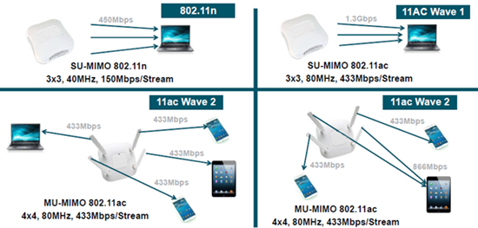
WTF is MIMO?

Slide 18
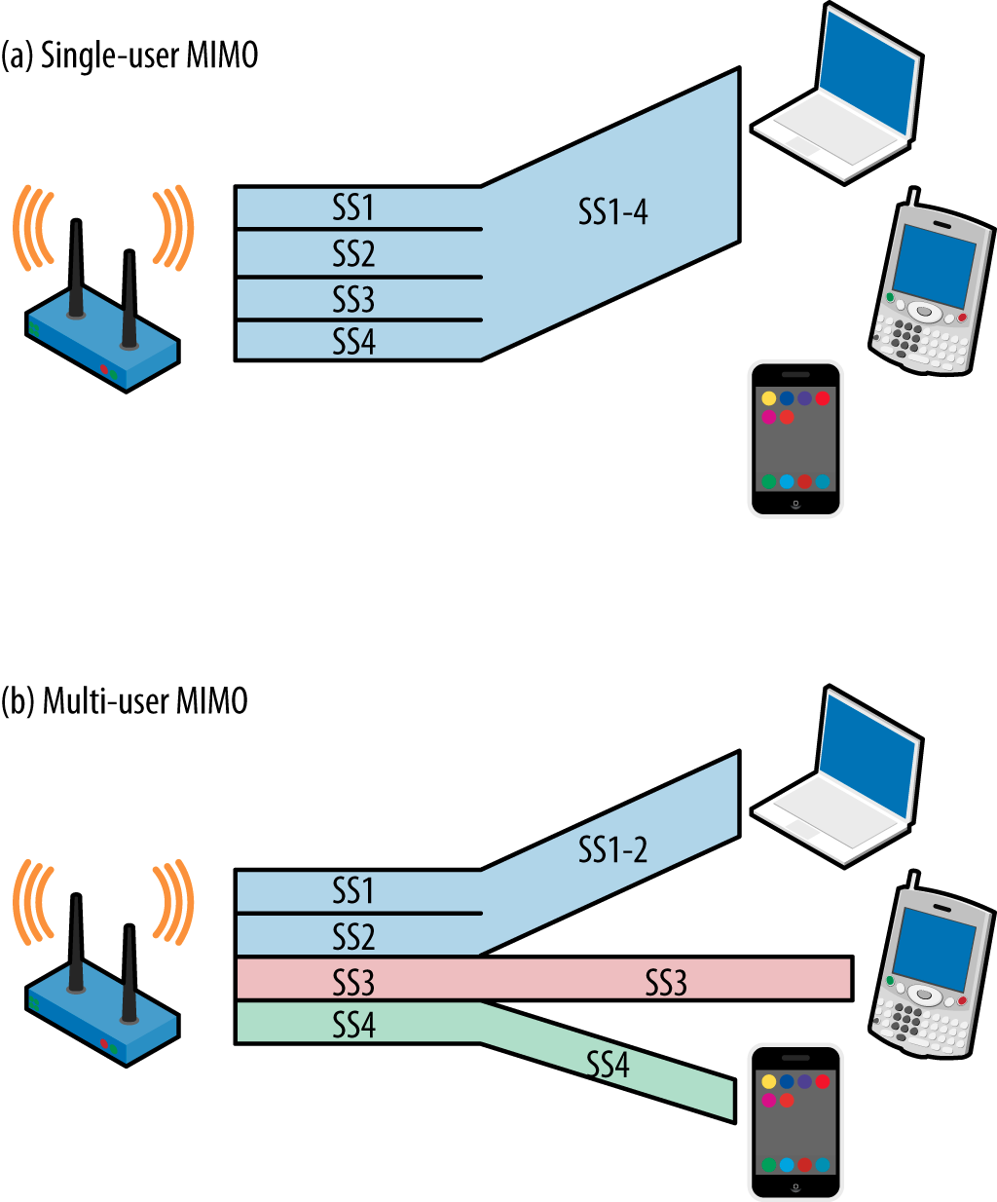
MIMO vs MU-MIMO

Slide 19
Channels and plans

Slide 20
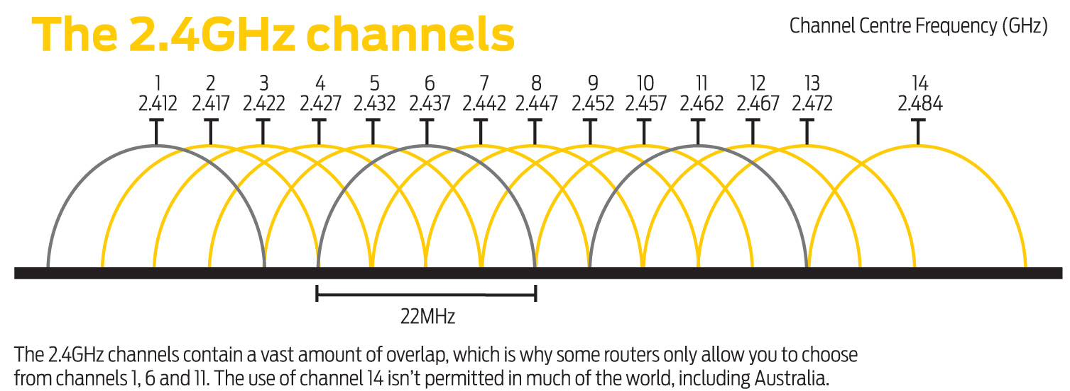
802.11b channels

Slide 21
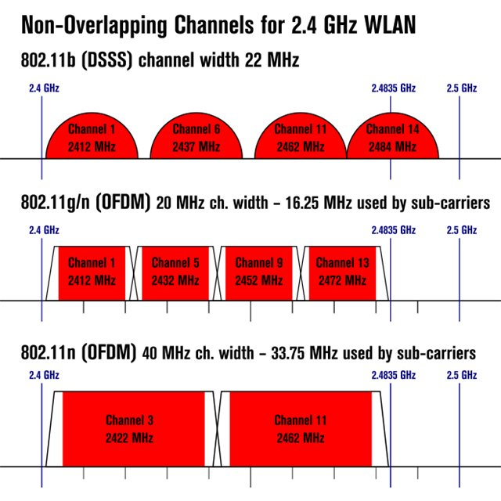
2.4GHz channel plan world

Slide 22
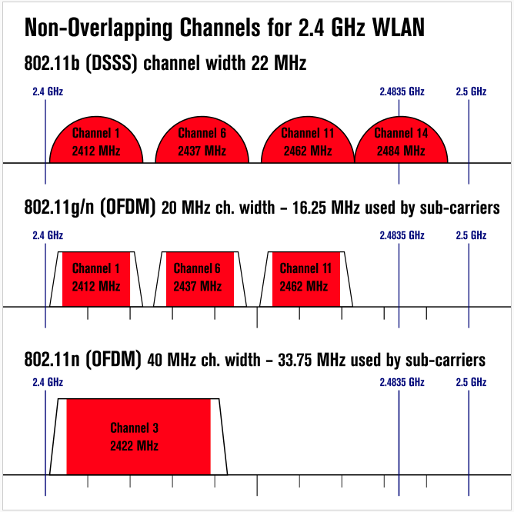
2.4GHz channel plan US

Slide 23
Channel plans
US: 1 – 6 – 11
JP: 1 – 5 – 9 – 13 – 14 for 802.11b
WORLD: 1 – 5 – 9 – 13

Slide 24

IRL mistakes that killed 2.4GHz
WTF is channel plan?
More bandwidth → more speed
More power → more speed

Slide 25

Home Wi-Fi tweaks
Use ACS or set channel to most free (11 usually)
Use 40MHz wisely
Lower TX power if possible

Slide 26
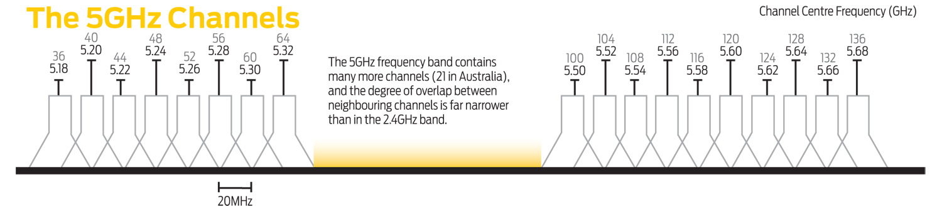
5GHz channels

Slide 27
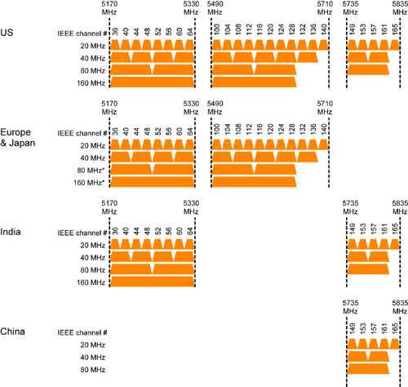
5GHz WORLD WIDE

Slide 28
Country → RF limits → CRDA
Allowed almost everywhere:
Channels: 1- 11
Signal strength (20dBm = 100mW)
Omnidirectional antenna (6dBi)

Slide 29
Free channel?
Уровень на входе приемника выше уровня среднего шума
На входе приемника есть реальный сигнал
Комбинированный = 1 + 2
Получение реального сигнала за фиксированный промежуток времени
Комбинированный = 1 + 4
Уровень на входе приемника выше уровня -82dBm, но меньше -62dBm. + канал занят, если уровень больше -72dBm и можно декодировать сигнал
https://wireless.wiki.kernel.org/en/users/documentation/acs

Slide 30
802.11 XXX

Slide 31
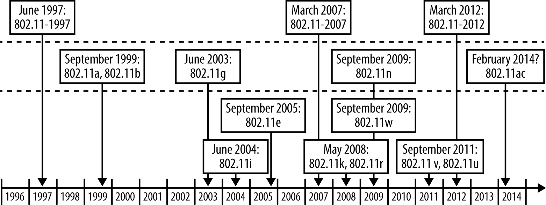
802.11 timeline

Slide 32
802.11i
Security mechanisms for 802.11
Auth, crypto
Draft: 24 June 2004
Released: IEEE 802.11-2007
P.S. China has WAPI https://en.wikipedia.org/wiki/WLAN_Authentication_and_Privacy_Infrastructure

Slide 33
802.11e
Wi-Fi Multimedia (WMM), Wireless Multimedia Extensions (WME)
QoS for 802.11

Slide 34
802.11d
802.11d - is an amendment to the IEEE 802.11 specification that adds support for "additional regulatory domains".
Used to regulate:
Channelization
Hopping patterns
As of January 1, 2015, the U.S. Federal Communications Commission banned the use of 802.11d within the U.S.

Slide 35
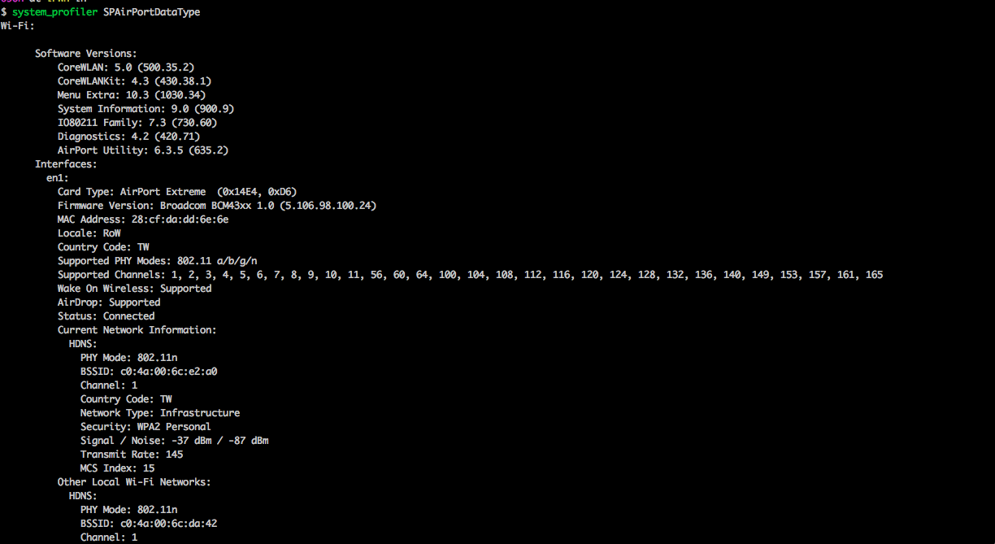
802.11d

Slide 36
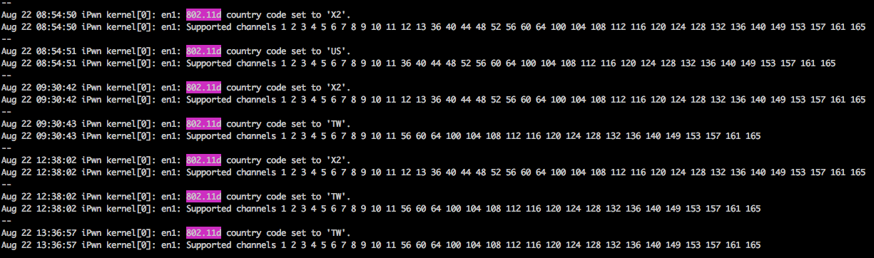
802.11d in the wild

Slide 37
802.11d OSX fix
http://www.hub.ru/wiki/802.11d
https://github.com/0x90/osx-scripts/blob/master/wifi_cc.sh

Slide 38
2.4GHz, 5GHz? …8(
802.11 frequency ranges:
900 MHz (802.11ah)
2.4 GHz (802.11b/g/n)
3.6 GHz (802.11y)
4.9 GHz (802.11y) Public Safety WLAN
5 GHz (802.11a/h/j/n/ac)
5.9 GHz (802.11p)
60 GHz (802.11ad)

Slide 39
802.11y
3.65-3.7GHz, 54Mbit/s, 4.9 GHz. US only? Public Safety WLAN 50 MHz of spectrum from 4940 MHz to 4990 MHz (WLAN channels 20–26) are in use by public safety entities in the US. Cisco 3202 4.9GHz Wireless Mobile Interface Card

Slide 40
802.11p
5.9Ghz, Wireless Access in Vehicular Environments (WAVE) 802.11p In Europe used as a basis for the ITS-G5 standard, supporting the GeoNetworking vehicle2vehicle2infrastructure communication.
Intellectual Transport System. =^.^=

Slide 41
802.11ad
60 GHz,WiGig. 7Gbit/s, 10m, beamforming, wireless display/HDMI, uncompressed video

Slide 42
802.11ah
900 MHz operates in sub-gigahertz unlicensed bands.

Slide 43
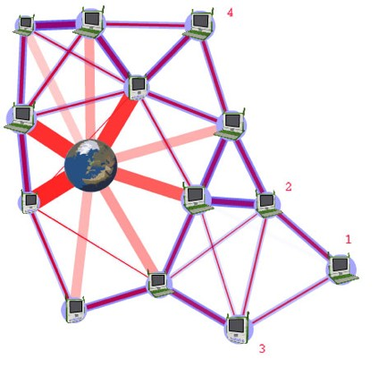
802.11s = mesh

Slide 44
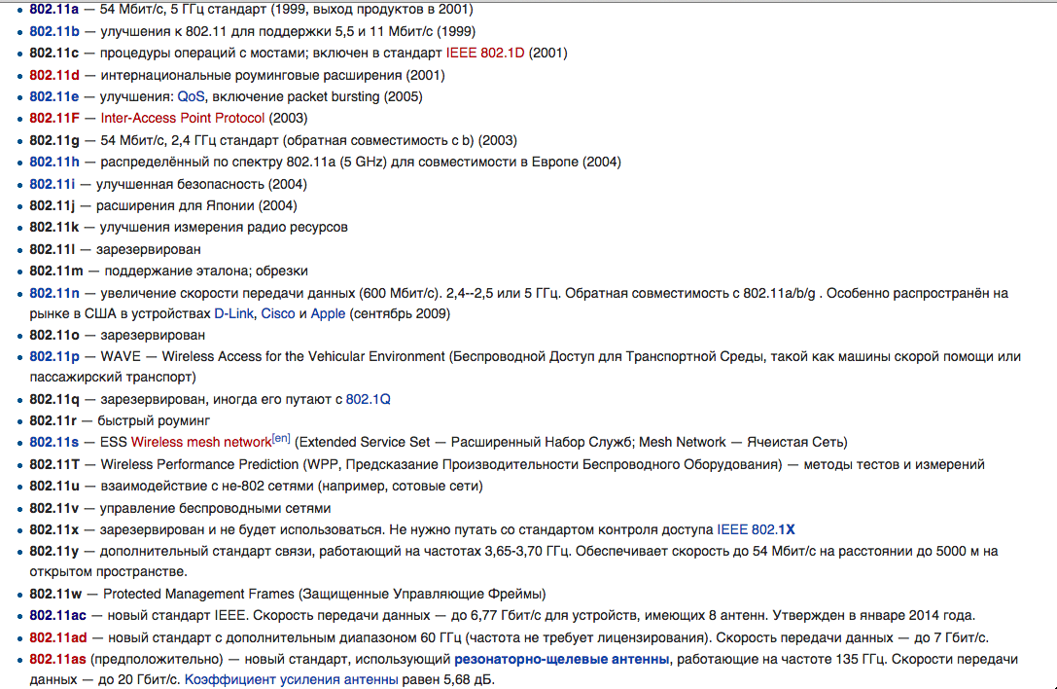
…and many more

Slide 45
ANTENNA

Slide 46

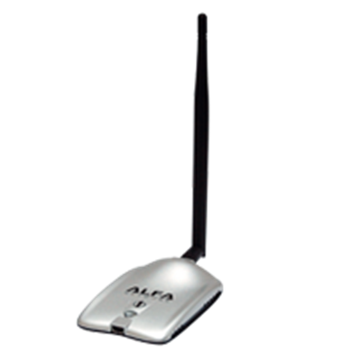
?
+
=

Slide 47
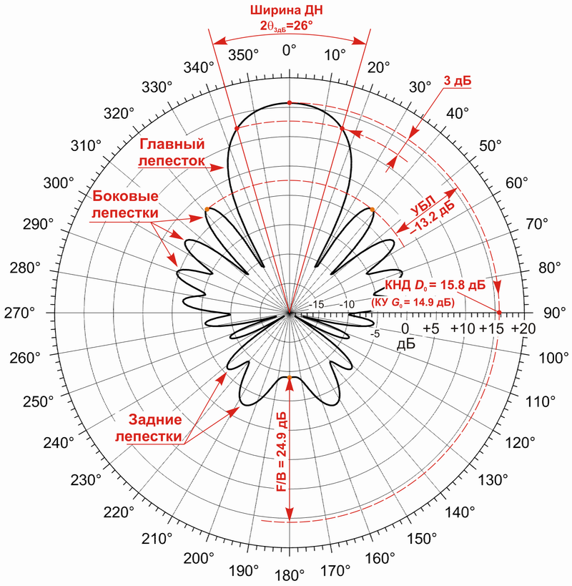
Основные характеристики антенн

Slide 48
Основные Виды антенн в сетях WiFI
Штыревые / всенаправленные – спиральные
Волновой канал – Уда-Яги
Панельные – патч-антенны
Параболические – зеркальные
Секторные – волноводно-щелевые

Slide 49
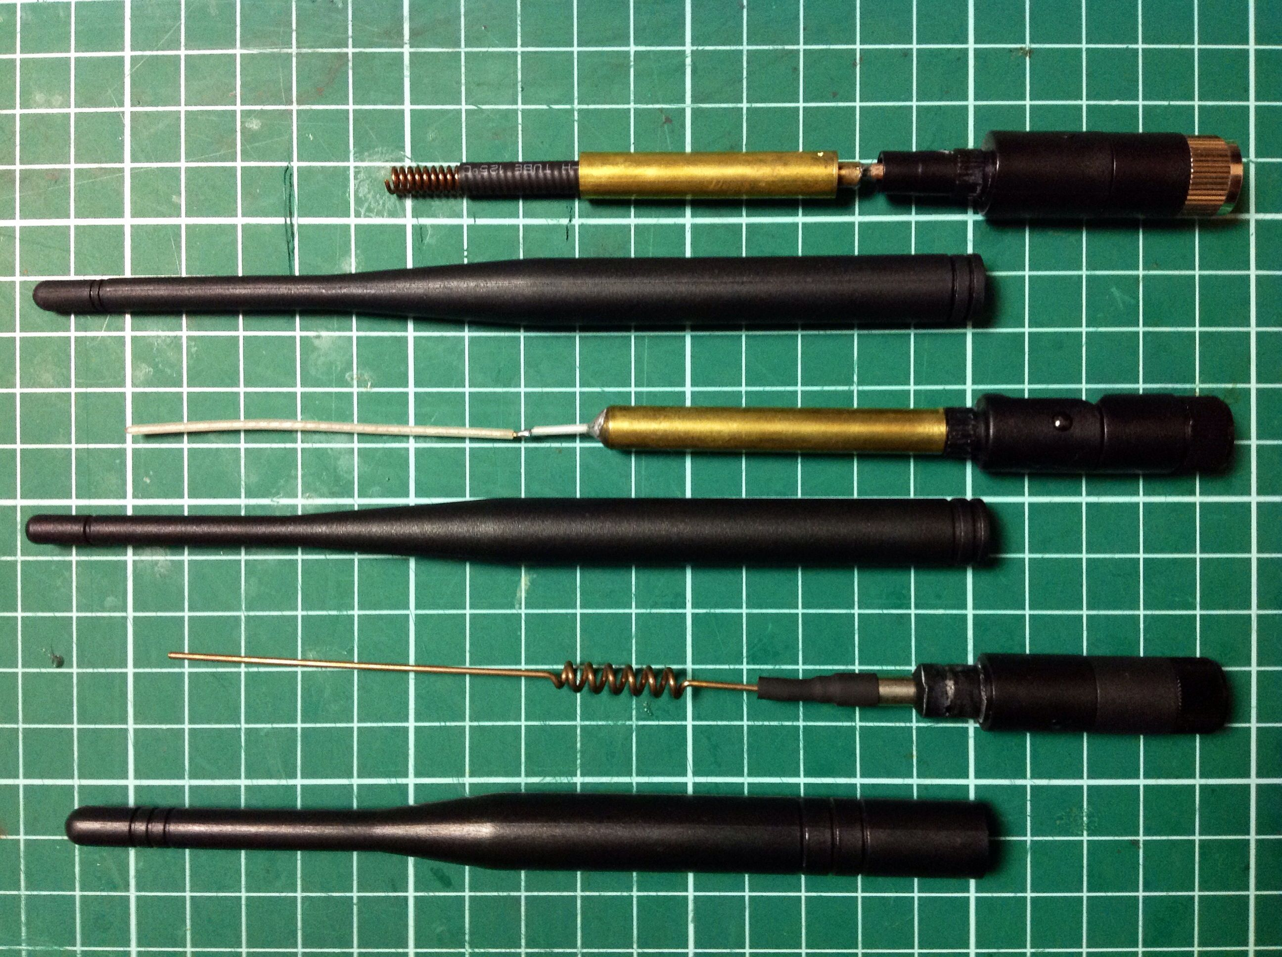
Спиральные антенны

Slide 50
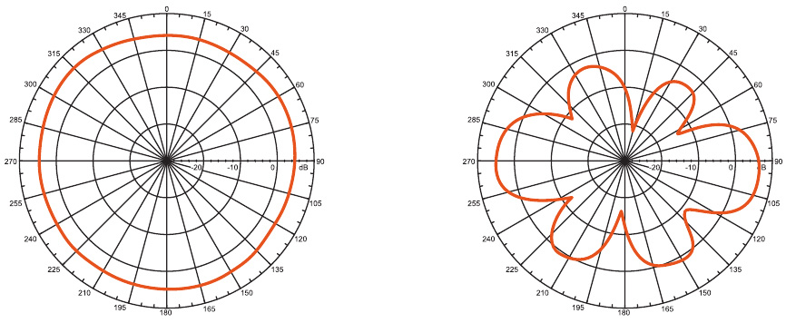
Спиральные антенны

Slide 51


Волновой канал

Slide 52
Волновой канал

Slide 53
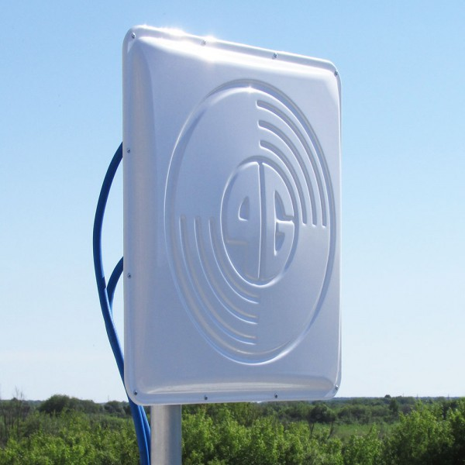

Патч антенны

Slide 54
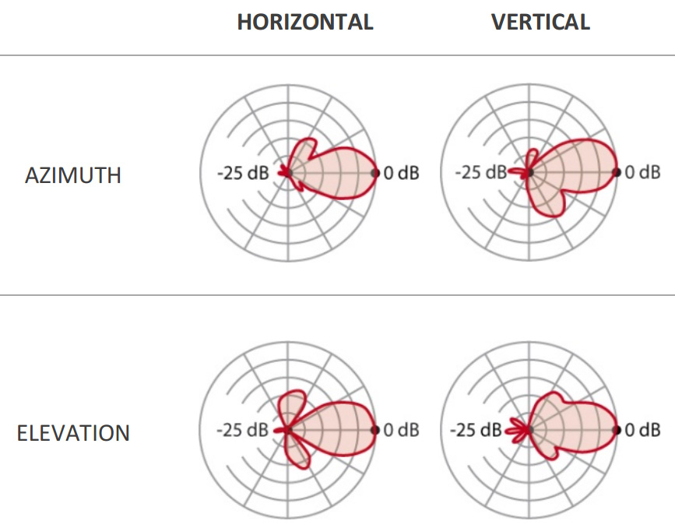
Патч антенны

Slide 55

Зеркальные Антенны

Slide 56
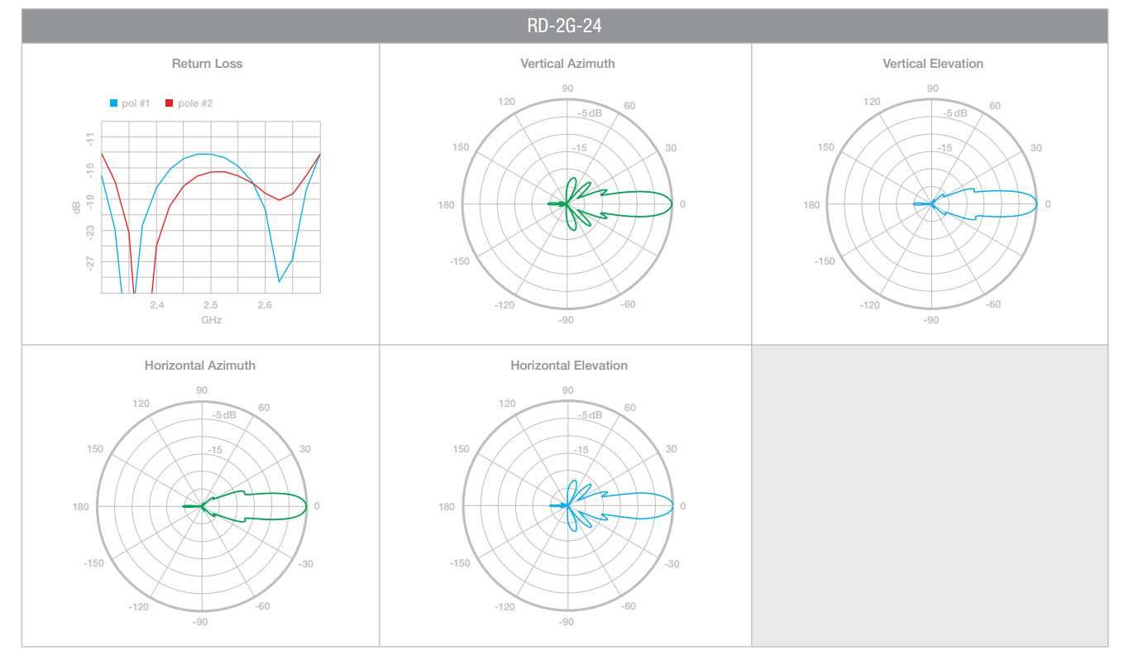
Зеркальные Антенны

Slide 57


Волноводно-щелевые Антенны

Slide 58
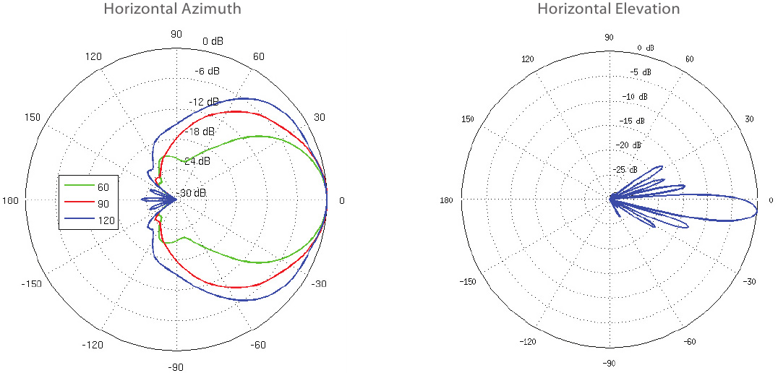
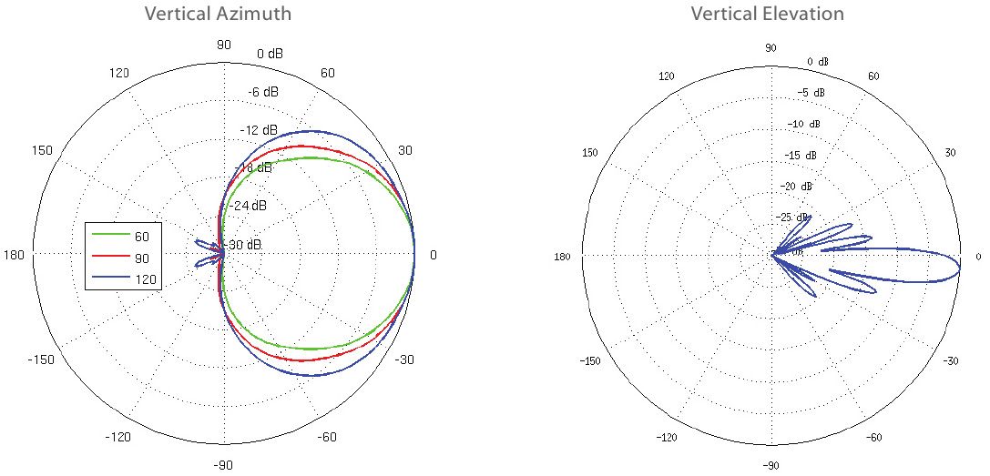
Волноводно-щелевые Антенны

Slide 59
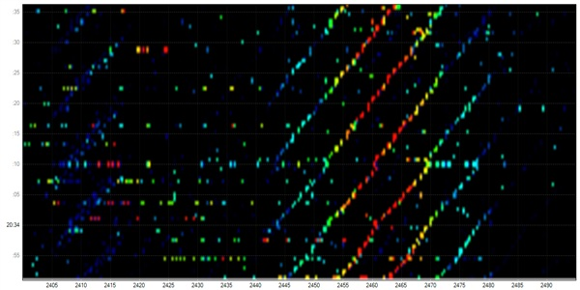
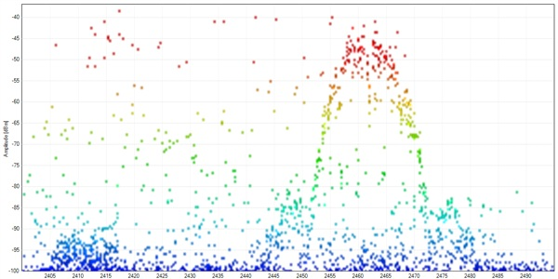

Slide 60
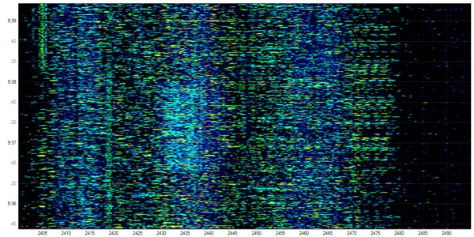
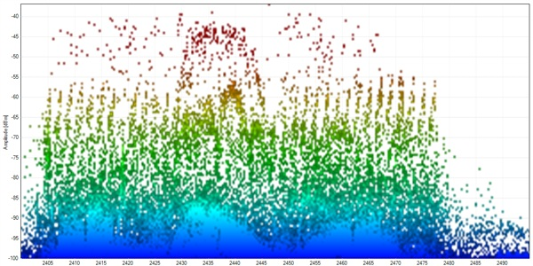

Slide 61
HARDWARE

Slide 62
.:MODES:.
STA/Managed– station operating
AP/Master – access point
MON – passive monitor channel
INJMON – monitor+injection (mac80211)
AdHoc/IBSS – computers without AP
WDS – static WDS
Mesh – many to many

Slide 63
CARDS
TP-Link TL-WN722N Atheros AR9271 (2.4 GHz)
Alfa AWUS036H RTL8187L (2.4 GHz)
Alfa AWUS036NHA (2.4G GHz) long range
Alfa AWUS051NH (2.4 & 5 GHz) long range
Ralink 3070 based cards (MediaTek now)
Any MAC80211 can be used!

Slide 64

MAX POWER DREAMS?

Slide 65

GOOD OLD TYMES….GO TO BOLIVIA!

Slide 66
HACKER = NO LIMITS
# ifconfig wlan0 down
# iw reg set BO BZ
# ifconfig wlan0 up
# iwconfig wlan0 channel 13
# iwconfig wlan0 txpower 30
or
# iw phy wlan0 set txpower fixed 30mBm

Slide 67
Correct way
Patch wireless-database
Patch CRDA
PROFIT!!!!
https://github.com/0x90/kali-scripts/blob/master/wireless.sh

Slide 68
802.11 OSI

Slide 69
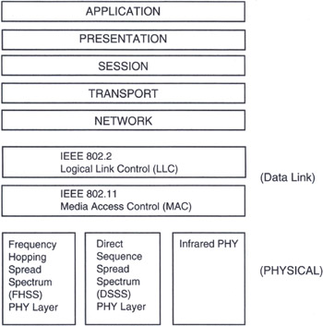
802.11 layer in OSI

Slide 70
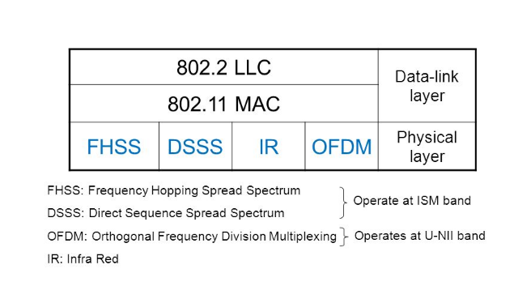

Slide 71
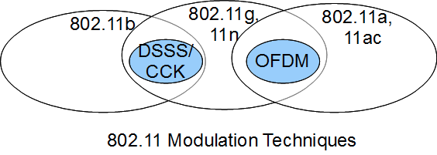
802.11 modulation

Slide 72
DSSS
DSSS (direct sequence spread spectrum) - метод прямой последовательности для расширения спектра

Slide 73
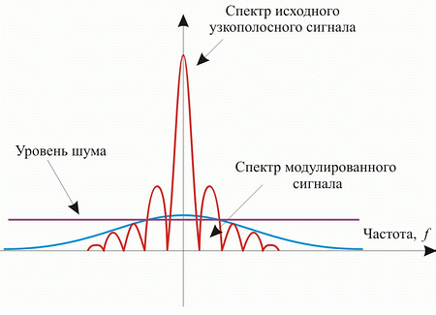
DSSS

Slide 74
OFDM
OFDM (англ. Orthogonal frequency-division multiplexing — мультиплексирование с ортогональным частотным разделением каналов) является цифровой схемой модуляции, которая использует большое количество близко расположенных ортогональных поднесущих.
Wi-Fi, WiMax, LTE

Slide 75
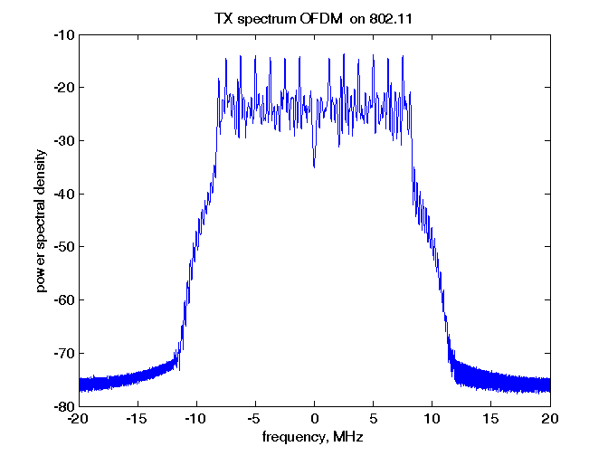
OFDM

Slide 76
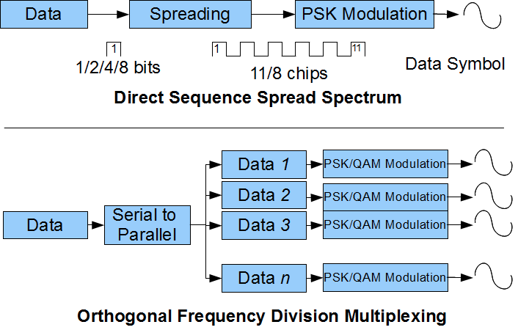
DSSS vs OFDM

Slide 77
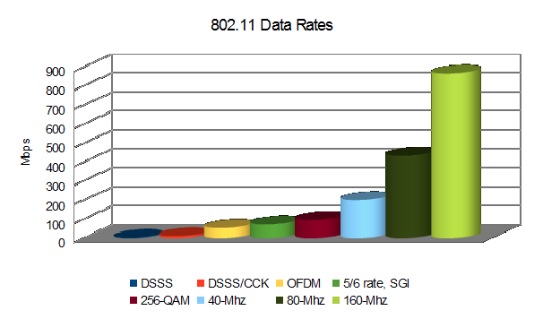
802.11 data rates

Slide 78
Physical layer
802.11a: OFDM - Мультиплексирование с ортогональным частотным разделением каналов
802.11b: DSSS - Расширение спектра методом прямой последовательности
802.11g: Extended Rate PHY (ERP) = OFDM
802.11n: MIMO OFDM
802.11ac: MU MIMO OFDM

Slide 79
802.11 security

Slide 80
802.11 SECURITY
Open
WEP
IBSS aka Ad-Hoc
WPA
WPA2-Personal
WPA2-Enterprise

Slide 81
management frame types
Authentication frame
Deauthentication frame
Association request frame
Association response frame
Disassociation frame
Beacon frame
Probe request frame
Probe response frame

Slide 82
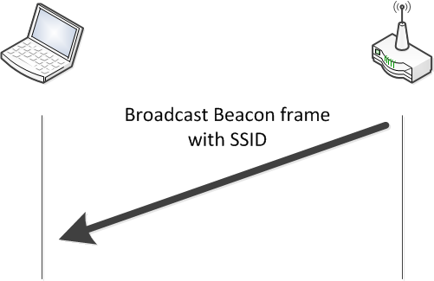
WiFi passive scan

Slide 83
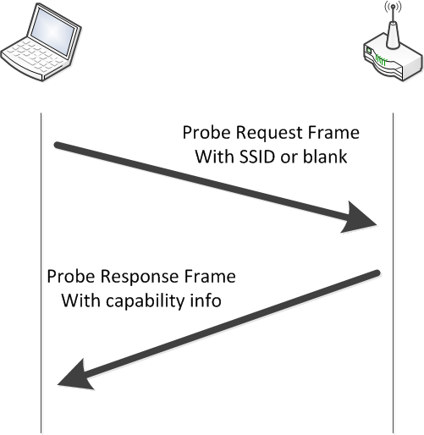
WiFi active scan

Slide 84
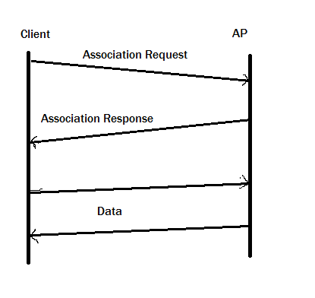
WiFi open auth

Slide 85
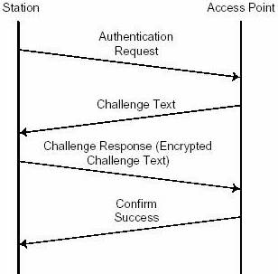
WiFi PSK auth

Slide 86
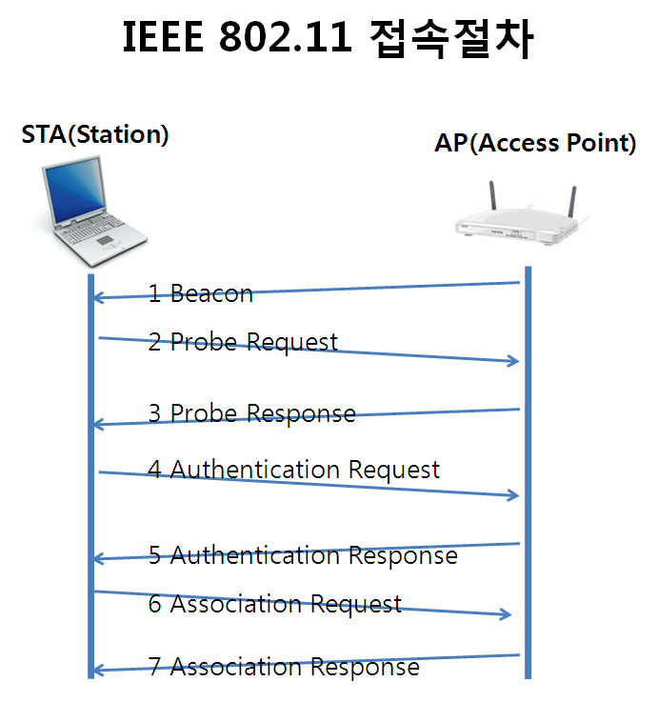
802.11 connection

Slide 87
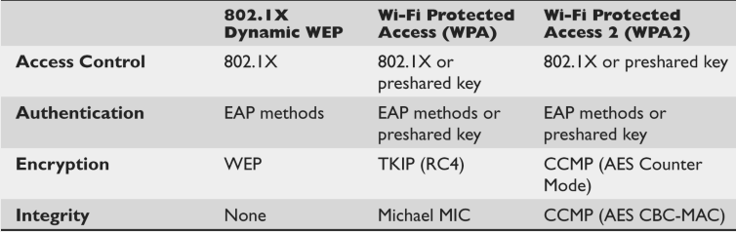
WEP/WPA/WPA2

Slide 88
WiFi authentication types
Open Authentication to the Access Point
Shared Key Authentication to the Access Point
EAP Authentication to the Network
MAC Address Authentication to the Network
Combining MAC-Based, EAP, and Open Authentication
Using CCKM for Authenticated Clients
Using WPA Key Management
http://www.cisco.com/c/en/us/td/docs/routers/access/wireless/software/guide/SecurityAuthenticationTypes.html

Slide 89
HACKING

Slide 90
What to hack?
WiFi network (AP)
WiFi clients
Almost like fishing and XSS.
Active and passive.
May be combined.

Slide 91
TOOLS
wifite r112
kismet, horst, aircrack-ng, mdk3, wifijammer
pyrit, cowpatty, hashcat
KARMA, MANA, Hostapd-WPE
reaver, pixie-wps, WPSPIN.sh, BullyWPS,
FruityWiFi, Snoopy-ng, modwifi
scapy + impacket + /dev/brain + /dev/hands

Slide 92
RFMON
Like promiscuous mode but at lower layer
Used to receive ALL frames
Used for sniff and injection
Advice: don’t kill network-manager – free the card
# airmon-ng start wlan0
# airodump-ng wlan0mon
… may be use wireshark?

Slide 93
Radiotap
Radiotap is a de facto standard for 802.11 frame injection and reception.
Radiotap is pseudo layer
http://www.radiotap.org/

Slide 94
WEP HACKING

Slide 95
WEP
WEP = Wired Equivalent Privacy
First WiFi crypto
WEP = RC4 + CRC32 + XOR
LENGTH(KEY) = 40 (1997)
LENGTH(KEY) = 104 (2001)
Has many bugs
Can be hacked in 10 minutes
Almost dead. Deprecated since 2004.

Slide 96
WEP weakness
HACK RC4 = HACK WEP
SMALL IV (init vector) = HACK
CRC weakness
NO AUTH, ONLY CRYPTO!

Slide 97
Атака на WEP
Направленная антенна => собираем IV с точки доступа
Антенна с широкой диаграммой => точка доступа + клиенты

Slide 98
WPA/WPA2 HACKING

Slide 99
WPA/WPA2 handshake catching
1. Пассивный режим:
Секторная антенна или всенаправленная антенна, желательно карта с MIMO
2. Активный режим:
Две сетевых карты: Одна мощная карта с направленной антенной для deauth, вторая карта с секторной антенной для перехвата в пассивном режиме.

Slide 100
HANDSHAKE CATCHING
Airodump-ng capture:
airodump-ng -c 9 --bssid 00:14:6C:7E:40:80 -w output.cap --showack wlan1mon
Pyrit capture and strip:
pyrit -r wlan1mon -o $(date +%Y-%m-%d_%H:%M:%S)_stripped.cap stripLive

Slide 101
DEAUTH TO HELP
aireplay-ng -1 0 -e teddy -a 00:14:6C:7E:40:80 -h 00:0F:B5:88:AC:82 mon0
aireplay-ng -1 6000 -o 1 -q 10 -e teddy -a 00:14:6C:7E:40:80 -h 00:0F:B5:88:AC:82 mon0
Wifijammer.py is the best solution from the box for deauth. Launched on separate card in practice.

Slide 102
HANDSHAKE BRUTEFORCE
Hashcat
Pyrit
Cowpatty
Cloudcracker

Slide 103
WPA/WPA2 hacking protections?
SSID hidden
802.11w
IDS solutions arriving

Slide 104

HALF HANDSHAKE STORY

Slide 105
Questions
Do we REALY need all 4 frames for handshake cracking?
What will happen if the client will try to connect to the same SSID with wrong password?

Slide 106
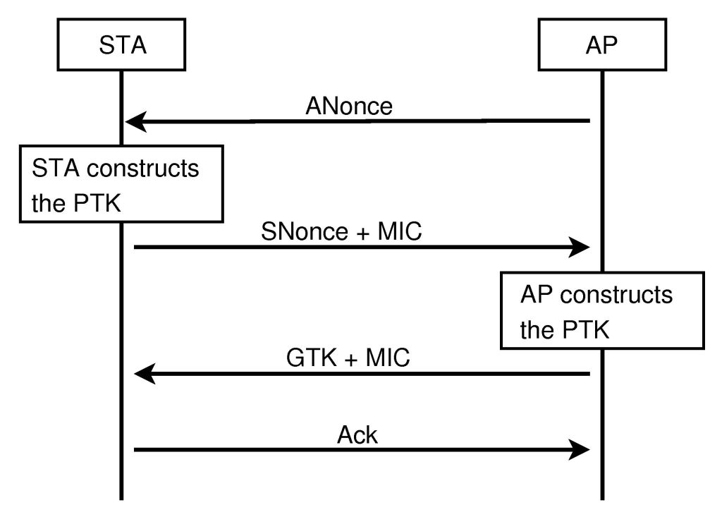
BAD/HALF HANDSHAKE

Slide 107
HALF HANDSHAKE TOOLS
Pyrit --all-handshakes : Use all handshakes instead of the best one
https://github.com/dxa4481/WPA2-HalfHandshake-Crack
halfHandshake.py -r sampleHalfHandshake.cap -m 48d224f0d128 -s SSID_HERE

Slide 108
PoC thoughts
Make custom HostAP fork
Combine MANA and password auth with random password
Write own access point from scratch

Slide 109
Lame PoC
Hardware: TP-Link 3020/3040/3220/..
Firmware: Custom OpenWRT based
http://semaraks.blogspot.ru/2014/12/wispi-ver-11-for-tp-link-mr3020-mini.html
Attack: KARMA + Randoom password @ hostapd.conf
Cracking: pyrit --all-handshakes

Slide 110
ADVANCED FUTURE
Hardware: Atheros chips
Software: Python + Scapy + FakeAP + WiFi MAP database
Cracking: pyrit --all-handshakes
PWNiNiNG: setting different password for different client based on SSID database + MiTM attacks

Slide 111
WPS HACKING

Slide 112
WPS
WPS – wireless protected setup
Designed for connecting printers and other embedded devices
Used by hackers to easily hack Wi-Fi

Slide 113
WPS HACKING WAYS
WPS PIN brute force
WPS PIN generation
WPS PIN guessing

Slide 114
WPS BRUTE ALGO
If the WPS Registration Protocol fails at some point, the Registrar will send a NACK message.
If the attacker receives a NACK message after sending M4, he knows that the first half of the PIN was incorrect. See definition of R-Hash1 and R-Hash2.
If the attacker receives a NACK message after sending M6, he knows that the second half of the PIN was incorrect.

Slide 115
WPS PIN brute force
How many to brute? 8? 7? 4+3=>10^4+10^3
Направленная антенна + подбор тракта по мощности
Wifite, reaver-wps, bully, BullyWPSRussian.sh, ReVdK3-r2.sh

Slide 116
WPS PIN generation
WPS_PIN=SOME_ALGO(MAC_ADDRESS)
PIN = RAND(SERIAL) is not really random too
Serial disclosure in Beacon frames at vendor specific fields
Vulnerable vendors: ZyXELL, D-Link, Belkin, Huawei
Reaver -W, --generate-pin Default Pin Generator [1] Belkin [2] D-Link [3] Zyxel
Different custom pin generators https://github.com/devttys0/wps

Slide 117
PIXIE WPS/PIXIE DUST
"pixie dust attack" discovered by Dominique Bongard in summer 2014
Weak PRNG
Pixiewps for _OFFLINE_ brute force

Slide 118
PIN GUESS
Good PRNG @ embedded devices is a problem. E-S1 and E-S2 need to be random.
NONCE = RAND(MAC) is not really random
NONCE = RAND(time=01.01.1970 by default) is no really random too
Vendors: Realtek, Ralink, Broadcom, MediaTek
Tools: wifite fork, Pixiewps, reaver t6x fork

Slide 119
Protections?
WPS activation for 1 minute after BUTTON pressed (mgts)
PIN from the end: 9999****
WPS brute force timeout
WPS brute force ban by MAC

Slide 120
WPA ENTERPRISE HACKING

Slide 121
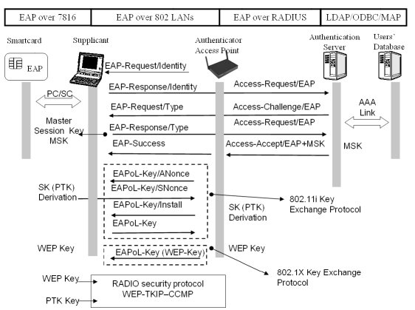
WPA-Enterprise

Slide 122
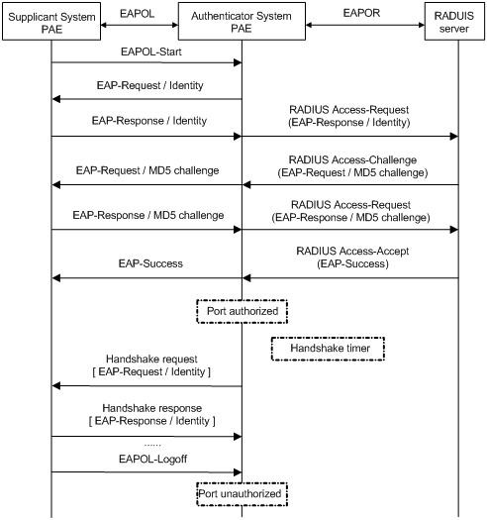
EAP,EAPOL/EAPOR

Slide 123
WiFi + EAP
EAP-TLS
EAP-MD5
EAP-SIM
EAP-AKA
PEAP
LEAP
EAP-TTLS
http://en.wikipedia.org/wiki/Extensible_Authentication_Protocol

Slide 124
PASSIVE Wi Fi HACKING

Slide 125


Slide 126
Abbreviations part 1
SSID – Service Set Identifiers (ESSID)
BSSID – Basic service set identification (AP MAC)
RSSI – Received Signal Strength Indication
CINR – Carrier to Interference + Noise Ratio
ACS – Auto Channel Selection
WEP – Wired Equivalent Privacy
WPA – Wi-Fi Protected Access aka Robust Secure Network (RSN)

Slide 127
Abbreviations part 2
AES – Advanced Encryption Standard
TKIP – Temporal Key Integrity Protocol
CCMP – Counter Mode with Cipher Block Chaining Message Authentication Code Protocol
EAP – Extensible Authentication Protocol
LEAP – Lightweight Extensible Authentication Protocol
RADIUS – Remote Authentication Dial In User Service

Slide 128
Abbreviations part 3
WPS/QSS – Wireless protected setup. WPS PIN → WiFi Password
PSK – Pre-Shared Key
MIC – Michael message integrity code
Authentication, Authorization, and Accounting (AAA) Key - Key information that is jointly negotiated between the Supplicant and the Authentication Server (AS). This key information is transported via a secure channel from the AS to the Authenticator. The pairwise master key (PMK) may be derived from the AAA key.
Pairwise Master Key (PMK) – The highest order key used within the 802.11i amendment. The PMK may be derived from an Extensible Authentication Protocol (EAP) method or may be obtained directly from a Preshared key (PSK).
Pairwise Transient Key (PTK) - A value that is derived from the pairwise master key (PMK), Authenticator address (AA), Supplicant address (SPA), Authenticator nonce (ANonce), and Supplicant nonce (SNonce) using the pseudo-random function (PRF) and that is split up into as many as five keys, i.e., temporal encryption key, two temporal message integrity code (MIC) keys, EAPOL-Key encryption key (KEK), EAPOL-Key confirmation key (KCK).
Group Master Key (GMK) - An auxiliary key that may be used to derive a group temporal key (GTK).
Group Temporal Key (GTK) - A random value, assigned by the broadcast/multicast source, which is used to protect broadcast/multicast medium access control (MAC) protocol data units (MPDUs) from that source. The GTK may be derived from a group master key (GMK).

Slide 129
BOOKS
802.11 Wireless Networks The Definitive Guide - Matthew Gast
802.11n A Survival Guide – Matthew Gast
Стандарты 802.11

Slide 130
Links
https://en.wikipedia.org/wiki/IEEE_802.11

Slide 131
My repos
https://github.com/0x90/kali-scripts
https://github.com/0x90/wifi-arsenal
https://github.com/0x90/wifi-scripts
https://github.com/0x90/esp-arsenal

Slide 132

802.11 pwner in real life

